Slide 1
Software Engineering and Professional Practice. Building Usable Software. Unit 6: Software Project Management Part 2: Project Scheduling
Anis Zarrad
a.zarrad@bham.ac.uk

Slide 2
Outlines
Introduction
Project initiation
Project Planning
Project Execution
Monitor and Control
Project Closure

Slide 3
Project scheduling
The process of deciding how the work in a project will be organized as separate tasks, and when and how these tasks will be executed.
Estimate the calendar time needed to complete each task, the effort required and who will work on the tasks that have been identified.
Estimate the resources needed to complete each task:
disk space required on a server
time required on specialized hardware

Slide 4
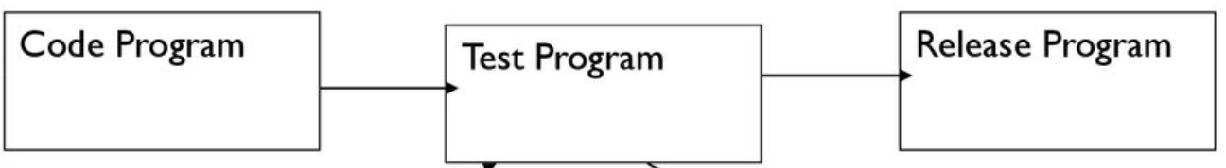
Project Scheduling Activities
Split project into tasks and estimate time and resources required to complete each task.
Organize tasks concurrently to make optimal use of workforce.
Minimize task dependencies to avoid delays caused by one task waiting for another to complete.
Dependent on project managers intuition and experience.
Prepare test report

Slide 5
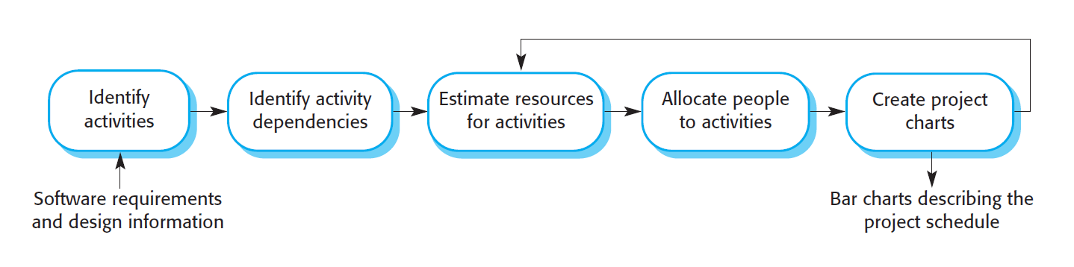
Project Scheduling Process

Slide 6
Project Activities
Project activities (Tasks) are the basic planning elements.
Each activity has:
A duration (hours, days, months)
resources
a deadline by which the activity should be complete.
a defined end-point, which might be a document, the holding of a review meeting, the successful execution of all tests.

Slide 7
Project scheduling
Activity Network
GANTT Chart
Resources Chart
PERT Chart

Slide 8
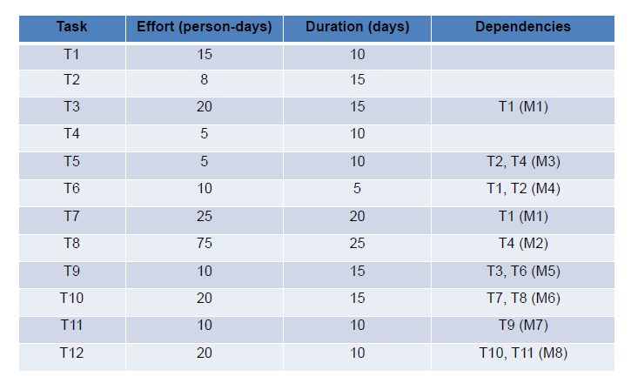
Tasks, durations and dependencies

Slide 9
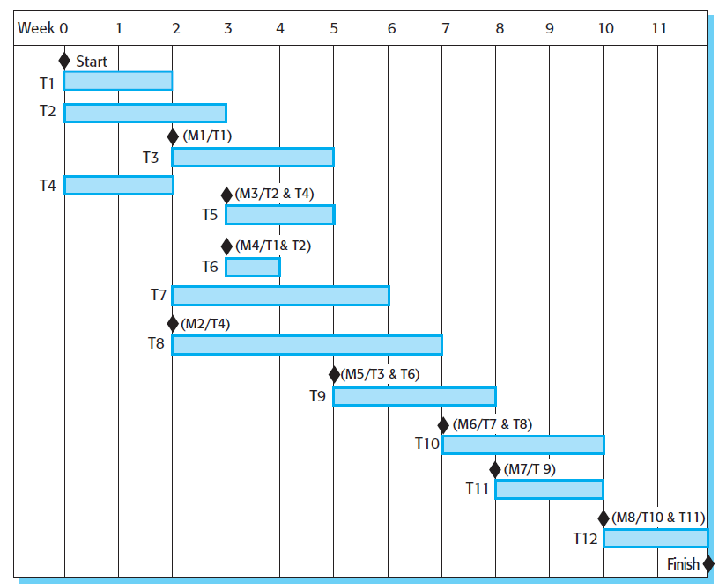
Activity bar Chart / Gantt Chart

Slide 10
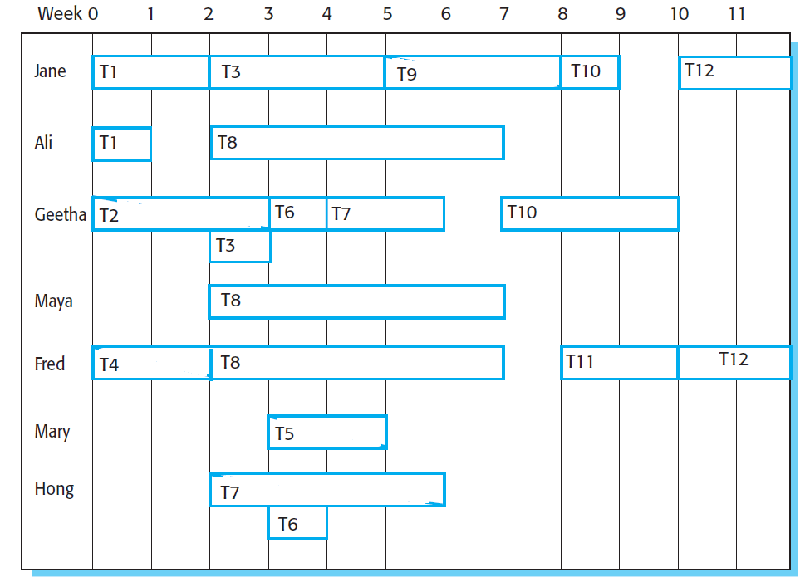
Staff allocation chart

Slide 11
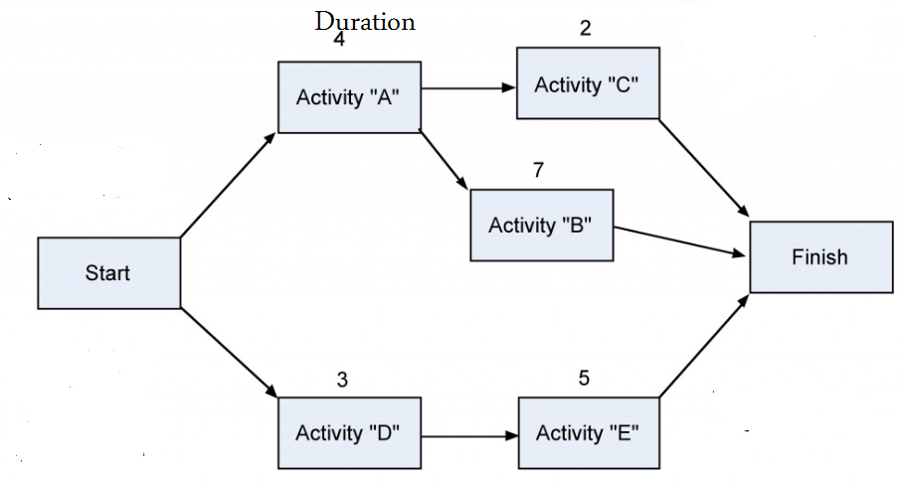
Precedence Diagramming Method (PDM) / Network Diagram
Activities are represented by boxes
Arrows show relationships between activities
Better at showing different types of dependencies

Slide 12
Network Diagram Practice
Task ID | Task Description | Dependencies | Duration (Days)
A | Establish project |  | 5
B | Customer requirements | A | 15
C | Produce software specifications | A | 5
D | Write test plan | A | 15
E | Write code | C, D | 15
F | Developers testing | B, E | 5
G | Installation | F | 5

Slide 13
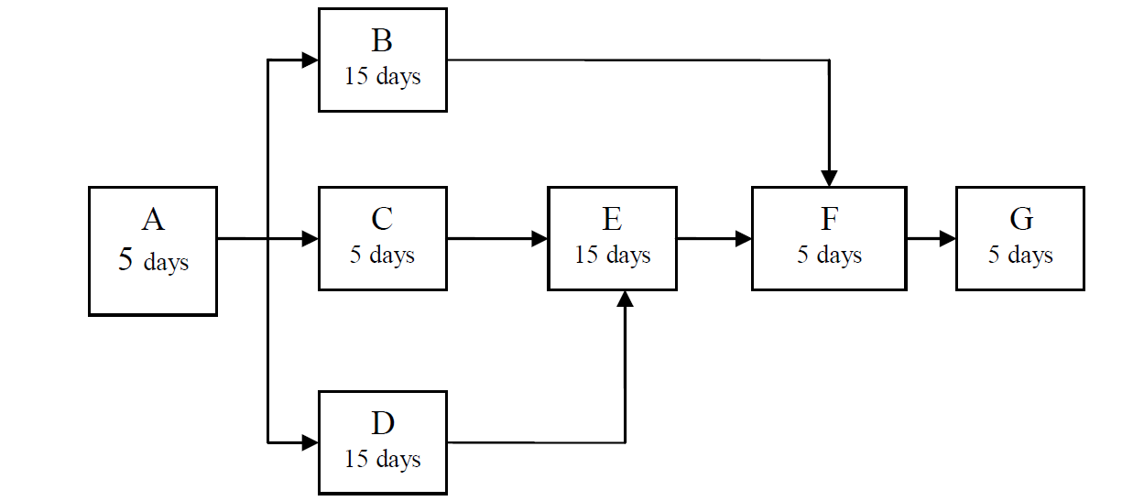
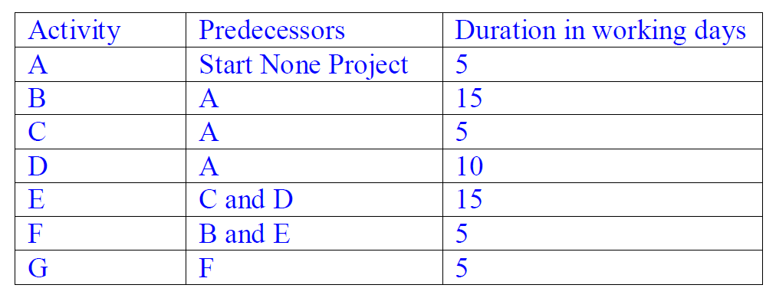
Practice
45 Days, Why
What is the project duration ?

Slide 14
Critical path Method
CPM is a project network analysis technique used to predict total project duration
A critical path for a project is the series of activities that determines the earliest time by which the project can be completed
The critical path is the longest path through the network diagram and has the least amount of slack or float
the terms slack and float describe the length of time that an activity can be delayed without delaying the finish date of a subsequent activity, or the finish date of the entire project.

Slide 15
Finding Critical Path
First develop a good project network diagram
Add the durations for all activities on each path through the project network diagram
The longest path is the critical path

Slide 16
Example Finding a critical path
a. How many paths are on this network diagram?
b. How long is each path?
c. Which is the critical path?
d. What is the shortest amount of time needed to complete this project?
3 paths
Path 1: 5+15+5+5=30
Path 2: 5+5+15+5+5=35
Path 3: 5+15+15+5+5=45
c. Critical path Path 3
d. 45 Days

Slide 17
PERT Diagrams
PERT node
ID: task/activity identifier or name
ES | D | EF
ID
LS | S | LF
D: Duration
ES: Earliest Start time
EF: Earliest Finish time
LS: Latest Start time
LF: Latest Finish time
S: Slack= LS-ES

Slide 18
PERT Diagram
Early start : Is the earliest time that an activity can start. An activity near the end of the path will only start early if all of the previous activities in the path also started early.
Early finish: Is the earliest time that an activity can finish. It’s the date that an activity will finish if all of the previous activities started early and none of them slipped.

Slide 19
PERT Diagram
Late start: Is the latest time that an activity can start. If an activity is on a path that’s much shorter than the critical path, then it can start very late without delaying the project.
Late finish: Is the latest time that an activity can finish. If an activity is on a short path and all of the other activities on that path start and finish early, then it can finish very late without causing the project to be late.

Slide 20
PERT Diagram
Forward pass
Earliest Start Time (ES)
earliest time an activity can start
ES = maximum EF of immediate predecessors
Earliest finish time (EF)
earliest time an activity can finish
earliest start time plus activity time
EF= ES + duration
Backword pass
Latest Start Time (LS)
Latest time an activity can start without delaying critical path time
LS= LF - duration
Latest finish time (LF)
latest time an activity can be completed without delaying critical path time LF = minimum LS of immediate predecessors

Slide 21
PERT Diagram - Example
 | duration | dependencies
T1 | 10 | none
T2 | 15 | T1
T3 | 8 | T1
Compl. | - | T2, T3

Slide 22
PERT Diagram - Example
Forward pass
 | 15
T2
 | 10
T1
 | -
Compl
 | 8
T3

Slide 23
PERT Diagram - Example
Forward pass
 | 15
T2
ES for the starting one(s) is 0
0 | 10
T1
 | -
Compl
 | 8
T3

Slide 24
PERT Diagram - Example
Forward pass
 | 15
T2
EF = ES + D
0 | 10 | 10
T1
 | -
Compl
 | 8
T3

Slide 25
PERT Diagram - Example
Forward pass
 | 15
T2
10
0 | 10 | 10
T1
 | -
Compl
10
 | 8
T3

Slide 26
PERT Diagram - Example
Forward pass
10 | 15
T2
10
0 | 10 | 10
T1
 | -
Compl
10
10 | 8
T3
ES = maximum EF of immediate predecessors

Slide 27
PERT Diagram - Example
Forward pass
10 | 15 | 25
T2
25
10
0 | 10 | 10
T1
 | -
Compl
10
18
10 | 8 | 18
T3

Slide 28
PERT Diagram - Example
Forward pass
10 | 15 | 25
T2
25
10
0 | 10 | 10
T1
25 | - | 25
Compl
10
18
10 | 8 | 18
T3
ES = maximum EF of immediate predecessors

Slide 29
PERT Diagram - Example
10 | 15 | 25
T2
25
10
0 | 10 | 10
T1
25 | - | 25
Compl
 |  | 25
10
18
10 | 8 | 18
T3
LF = EF for the final activity
Backword pass

Slide 30
PERT Diagram - Example
10 | 15 | 25
T2
25
10
0 | 10 | 10
T1
25 | - | 25
Compl
25 |  | 25
10
18
LS = LF - D
10 | 8 | 18
T3
Backword pass

Slide 31
PERT Diagram - Example
10 | 15 | 25
T2
25
10
0 | 10 | 10
T1
25 | - | 25
Compl
25 | 0 | 25
10
18
Slack = LF - EF = LS - ES
10 | 8 | 18
T3
Backword pass

Slide 32
PERT Diagram - Example
10 | 15 | 25
T2
 |  | 25
25
10
25
0 | 10 | 10
T1
25 | - | 25
Compl
25 | 0 | 25
10
18
25
10 | 8 | 18
T3
 |  | 25
Backword pass

Slide 33
PERT Diagram - Example
10 | 15 | 25
T2
10 |  | 25
25
10
25
0 | 10 | 10
T1
25 | - | 25
Compl
25 | 0 | 25
10
18
25
10 | 8 | 18
T3
17 |  | 25
Backword pass

Slide 34
PERT Diagram - Example
10 | 15 | 25
T2
10 | 0 | 25
25
10
25
0 | 10 | 10
T1
25 | - | 25
Compl
25 | 0 | 25
10
18
25
10 | 8 | 18
T3
17 | 7 | 25
Backword pass
LF = minimum LS of immediate predecessors

Slide 35
PERT Diagram - Example
10 | 15 | 25
T2
10 | 0 | 25
25
10
10
25
0 | 10 | 10
T1
 |  | 10
25 | - | 25
Compl
25 | 0 | 25
10
18
17
25
10 | 8 | 18
T3
17 | 7 | 25
Backword pass

Slide 36
PERT Diagram - Example
10 | 15 | 25
T2
10 | 0 | 25
25
10
10
25
0 | 10 | 10
T1
0 | 0 | 10
25 | - | 25
Compl
25 | 0 | 25
10
18
17
25
10 | 8 | 18
T3
17 | 7 | 25
Backword pass

Slide 37
PERT Diagram - Example
10 | 15 | 25
T2
10 | 0 | 25
25
10
10
25
0 | 10 | 10
T1
0 | 0 | 10
25 | - | 25
Compl
25 | 0 | 25
10
18
17
25
10 | 8 | 18
T3
17 | 7 | 25
Backword pass
Critical path: T1-T2-Compl. (path with zero slack)

Slide 38
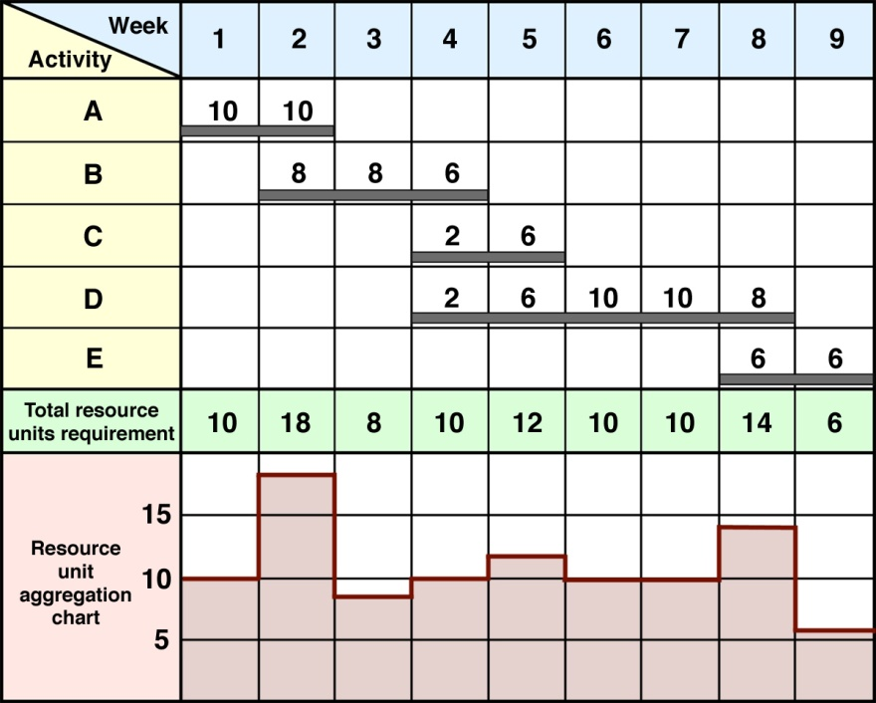
Project Resources
The total number of resource units for each time period can then be summed and a resource aggregation or load chart can be produced.

Slide 39
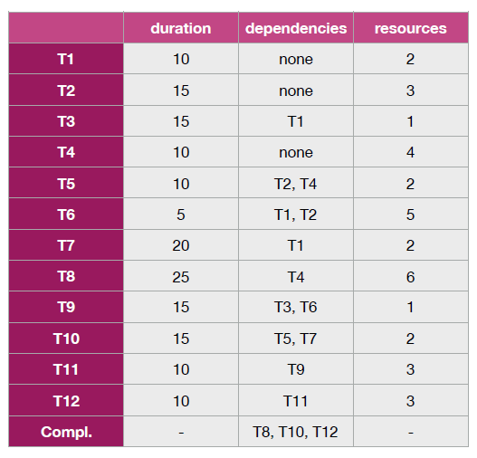
Practice
1- Draw the network Diagram
2- Find the critical path for this project

Slide 40
Take Home Message
Planning is not scheduling
Critical path is the longest path in the Gantt chart.
You can’t afford to misunderstand WBS . work breakdown structure is almost the core of project management.
Thank you

